Slide 1
How Helpful Meteorological Indicators Are In Predicting Drought Intensity?
BANSARI K. SHAH, FNU UJJWAL, NICHOLAS OGBONNA, SHIKHA C. PATEL, TRACEY LOOS
UNDER THE GUIDANCE OF DR. HUTHAIFA ASHQAR
UNIVERSITY OF MARYLAND
BALTIMORE COUNTY
DATA 601 – INTRODUCTION TO DATA SCIENCE

Slide 2
INTRODUCTION TO DROUGHTS:
Traditionally, drought can be classified into meteorological, agricultural, hydrological, and socioeconomic drought, based on both physical and socioeconomic factors.¹
Overall, the development and evolution of drought result from complicated interactions among meteorological anomalies, land surface processes, and human activities.¹
Meteorological Drought | related to the precipitation deficit over a prolonged period of time
Agricultural Drought | related to the deficit in soil moisture, which affects plant production and crop yield.
Hydrological Drought | related to the deficit of surface runoff, streamflow, reservoir, or groundwater level.
Socioeconomic Drought | associated with the supply and demand of some economic goods (e.g., water, food grains), which incorporates features or impacts of the other three types of drought
1. Hao Z., Singh V.P., & Xia Y., (2018). Seasonal Drought Prediction: Advances, Challenges, and Future Prospects. Reviews of Geophysics, 56, 108-141. <https://doi.org/10.1002/2016RG000549>

Slide 3
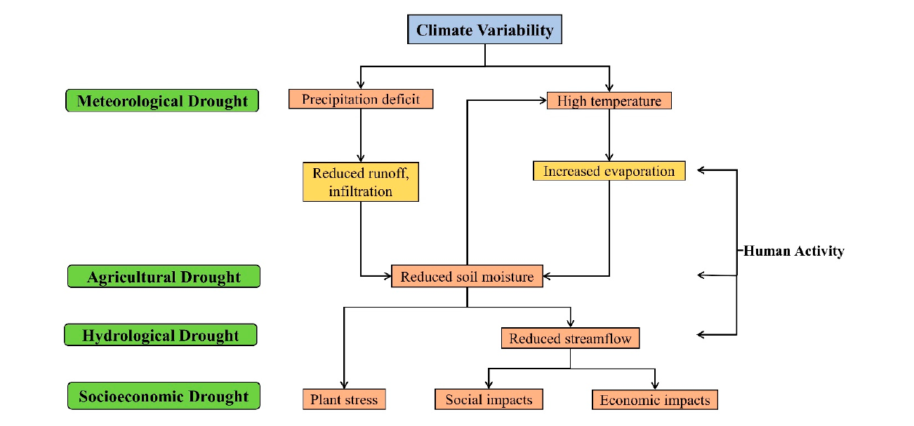
INTRODUCTION TO DROUGHTS:
FIGURE 1.
Image Source: “Climate-influenced relationships between hydrological cycle variables and drought types”. (Kim T-W, Jehanzaib M. Drought Risk Analysis, Forecasting and Assessment under Climate Change. Water. 2020; 12(7):1862. <https://doi.org/10.3390/w12071862>)

Slide 4
IMPACT OF DROUGHTS:
As per National Integrated Drought Information System (or NIDIS) :
38.95 % of the U.S. and 46.58% of the lower 48 states are in the drought this week.¹
92.2 million acres of crops in U.S. are experiencing drought conditions this week.¹
In 2012, US witnessed one of the most extensive drought since 1930s. 54.8 % of the U.S. was in drought in September 2012, according to the U.S. Drought Monitor records since 2000.²
It resulted in moderate to extreme drought conditions in more than half the country for a majority of 2012.²
The financial damage due to droughts is estimated to be around $249.7 billion during 1980-2019.³
1. <https://www.drought.gov/current-conditions>
2. <https://www.drought.gov/historical-information?dataset=0&selectedDateUSDM=20100803>
3. <https://www.climate.gov/news-features/blogs/beyond-data/2010-2019-landmark-decade-us-billion-dollar-weather-and-climate>

Slide 5
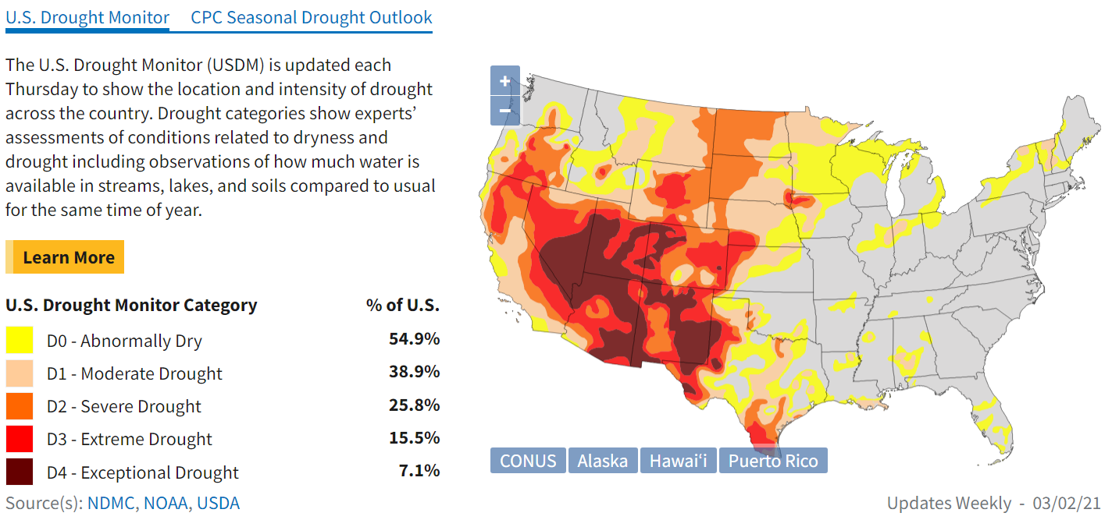
IMPACT OF DROUGHTS:
FIGURE 2.
Drought Monitor Data as on 2nd March 2021 Image Source: <https://www.drought.gov/>

Slide 6
WHY DROUGHT ANALYSIS MATTERS?
Drought is a complicated phenomenon and is among the least understood natural hazards due to its multiple causing mechanisms or contributing factors operating at different temporal and spatial scales.¹
Extensive impacts of drought in past decades at regional and global scales call for improved capability to cope with drought. ¹
The ultimate objective of drought prediction is to prepare a mitigation plan in advance, rather than resolve intellectual curiosity about nature.²
1. Hao Z., Singh V.P., & Xia Y., (2018). Seasonal Drought Prediction: Advances, Challenges, and Future Prospects. Reviews of Geophysics, 56, 108-141. <https://doi.org/10.1002/2016RG000549>
2. Park H, Kim K, Lee Dk. Prediction of Severe Drought Area Based on Random Forest: Using Satellite Image and Topography Data. Water. 2019; 11(4):705. <https://doi.org/10.3390/w11040705>

Slide 7
PROBLEM STATEMENT
What has been the trend of drought intensities in various US counties from 2014-2020?
How has the meteorological indicators varied during this time?
How strong is the correlation present between droughts and meteorological data?
How effectively can drought be predicted using meteorological indicators?
Which of these indicators are significant in drought predictions?

Slide 8
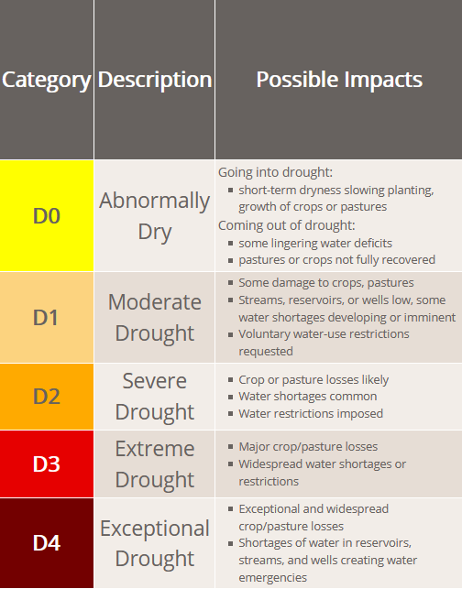
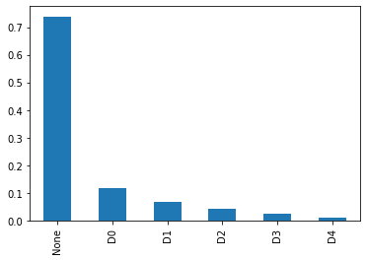
DATA
Kaggle: A classification dataset with 18 meteorological indicators and 1 drought intensity indicator. The drought intensity indicator assumes 1 of 6 values signifying the levels of drought.
Data obtained from the NASA Langley Research Center (LaRC) POWER Project funded through the NASA Earth Science/Applied Science Program.¹
FIGURE 3.
Image Source: <https://droughtmonitor.unl.edu/About/WhatistheUSDM.aspx>
FIGURE 4.
Image Source:
Imbalance in dataset
<https://www.kaggle.com/cdminix/us-drought-meteorological-data>
1. <https://www.kaggle.com/cdminix/us-drought-meteorological-data>

Slide 9
DATA
INDICATOR | DESCRIPTION
WS10M_MIN | Minimum Wind Speed at 10 Meters (m/s)
QV2M | Specific Humidity at 2 Meters (g/kg)
T2M_RANGE | Temperature Range at 2 Meters (C)
WS10M | Wind Speed at 10 Meters (m/s)
T2M | Temperature at 2 Meters (C)
WS50M_MIN | Minimum Wind Speed at 50 Meters (m/s)
T2M_MAX | Maximum Temperature at 2 Meters (C)
WS50M | Wind Speed at 50 Meters (m/s)
TS | Earth Skin Temperature (C)
INDICATOR | DESCRIPTION
WS50M_RANGE | Wind Speed Range at 50 Meters (m/s)
WS50M_MAX | Maximum Wind Speed at 50 Meters (m/s)
WS10M_MAX | Maximum Wind Speed at 10 Meters (m/s)
WS10M_RANGE | Wind Speed Range at 10 Meters (m/s)
PS | Surface Pressure (kPa)
T2MDEW | Dew/Frost Point at 2 Meters (C)
T2M_MIN | Minimum Temperature at 2 Meters (C)
T2MWET | Wet Bulb Temperature at 2 Meters (C)
PRECTOT | Precipitation (mm day-1)
Source: <https://www.kaggle.com/cdminix/us-drought-meteorological-data>

Slide 10
PREDICTIVE MODELING
Drought prediction generally refers to the prediction of drought severity (e.g., values of a specific drought indicator).¹
We mainly focus on finding the best meteorological features that can help in predicting drought severity and develop a machine learning model around it.
The data is available for 2000-2020 timeframe:
Dataset | Year Range (Inclusive) | Percentage (%)
Training Data | 2000-2014 | 70
Validation Data | 2015-2016 | 10
Testing Data | 2017-2020 | 20
1. Hao Z., Singh V.P., & Xia Y., (2018). Seasonal Drought Prediction: Advances, Challenges, and Future Prospects. Reviews of Geophysics, 56, 108-141. <https://doi.org/10.1002/2016RG000549>

Slide 11
SOURCES
Hao Z., Singh V.P., & Xia Y., (2018). Seasonal Drought Prediction: Advances, Challenges, and Future Prospects. Reviews of Geophysics, 56, 108-141. https://doi.org/10.1002/2016RG000549
Kim T-W, Jehanzaib M. Drought Risk Analysis, Forecasting and Assessment under Climate Change. Water. 2020; 12(7):1862. https://doi.org/10.3390/w12071862
Park H, Kim K, Lee Dk. Prediction of Severe Drought Area Based on Random Forest: Using Satellite Image and Topography Data. Water. 2019; 11(4):705. https://doi.org/10.3390/w11040705
Alley, W.M., 1984: The Palmer Drought Severity Index: limitations and assumptions. Journal of Climate and Applied Meteorology, 23: 1100–1109
https://www.drought.gov/
https://www.kaggle.com/cdminix/us-drought-meteorological-data
https://droughtmonitor.unl.edu/Data.aspx
https://www.drought.gov/historical-information?dataset=0&selectedDateUSDM=20100803
https://www.climate.gov/news-features/blogs/beyond-data/2010-2019-landmark-decade-us-billion-dollar-weather-and-climate
https://droughtmonitor.unl.edu/About/WhatistheUSDM.aspx

